Slide 1
Introduction
Data Engineering and Big Data

Slide 2
Agenda
Understanding Data
Understanding Data Engineering
The Data Challenge
Data warehouse – Data mart
Understanding Big Data
Big data Technology Landscape.
Big Data Use Cases
Big data Enablers
Big Data market
Limitations of conventional BI
Advent of Hadoop and its Eco System

Slide 3
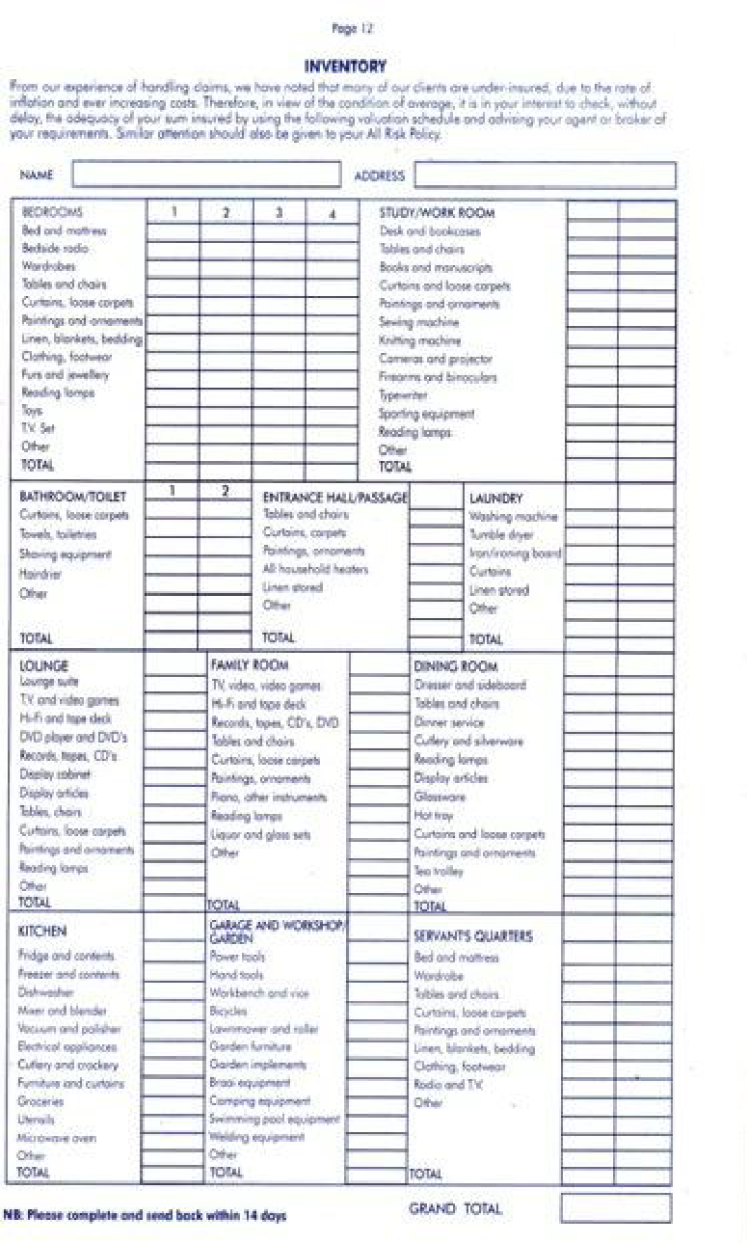

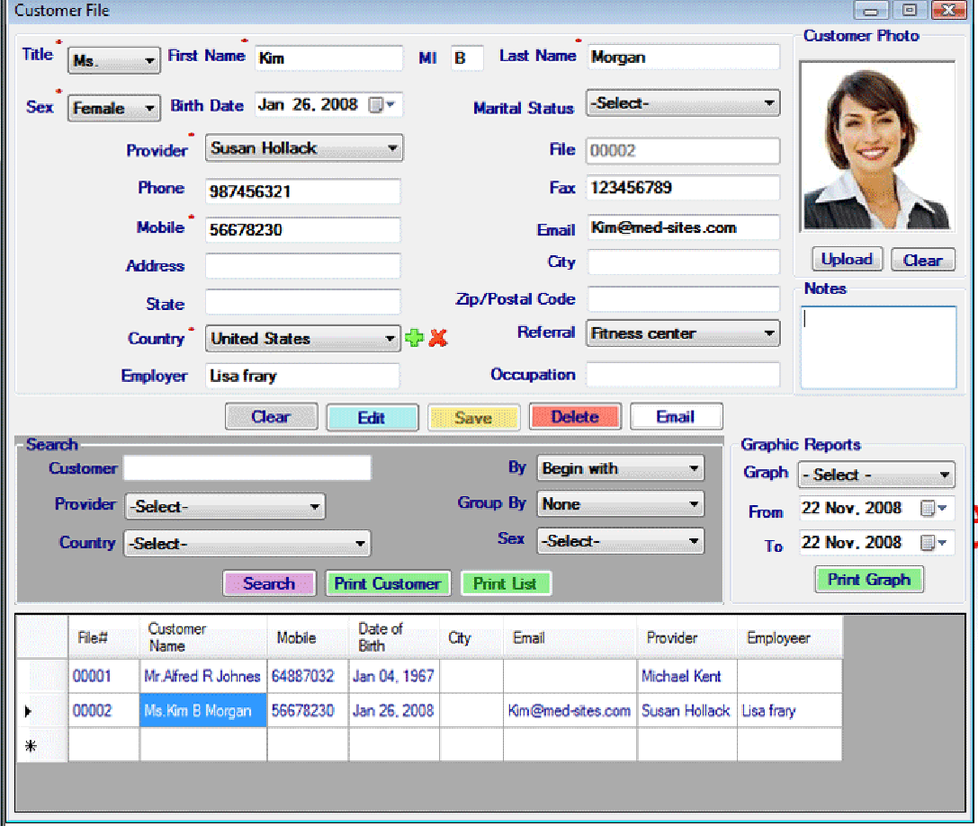




Understanding Data
What is data? A Customer’s record, Subscriber’s telephone # and address, a retail ticket, an insurance claim, an inventory list, a sales order, a flight ticket…etc.
This is how we perceive data today. But data is changing its form, even right now as we speak, data is changing.

Slide 4








Understanding Data - Data Amorphism
The manifestation of data has changed dramatically over the last few years. Data today is quite different from what data used to be a few years ago!

Slide 5
Data Warehousing concept
DWs are central repositories of integrated data from one or more disparate sources.
They store current and historical data in one single places that are used for creating analytical reports for workers throughout the enterprise.
The main source of the data is cleansed, transformed, catalogued, and made available for use by managers and other business.
Major components of Datawarehousing:
ETL – Extract Transform and Load
ELT – Extract Load and Transform

Slide 6
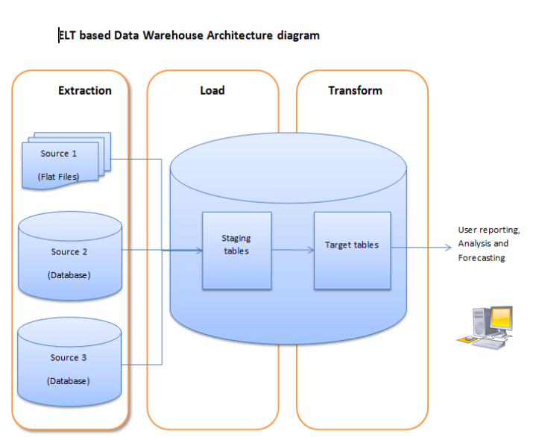
ETL – Extract Transform and Load

Slide 7
Benefits of Datawarehouse
Integrate data from multiple sources into a single database and data model.
Maintain data history, even if the source transaction systems do not.
Integrate data from multiple source systems, enabling a central view across the enterprise.
Improve data quality by providing consistent codes and descriptions, flagging or even fixing bad data.
Present the organization's information consistently.
Restructure the data so that it makes sense to the business users.
Make decision–support queries easier to write.

Slide 8
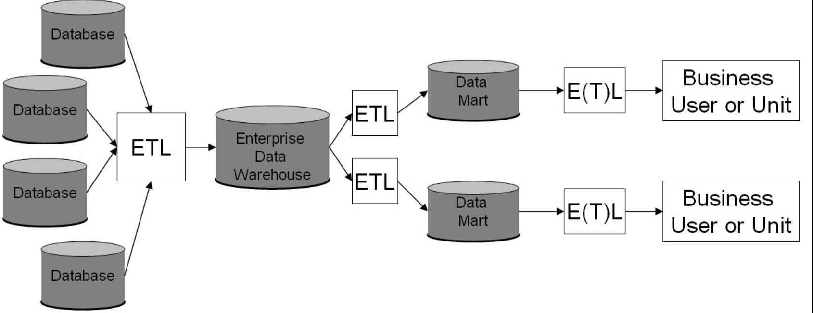
Overview of Datawarehouse

Slide 9
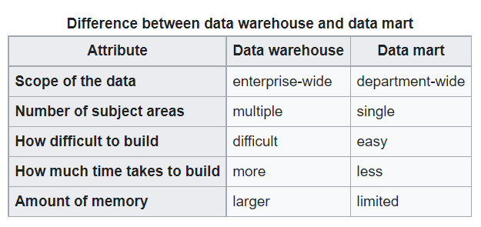
Data warehouse & Data mart

Slide 10
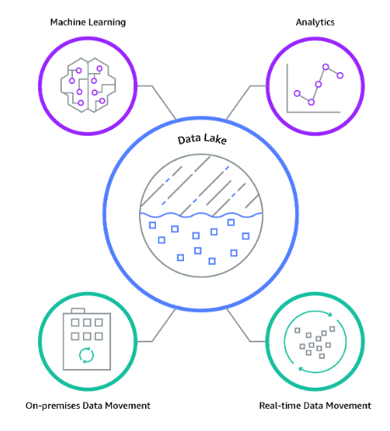
Data Lake
A data lake is a centralized repository that allows you to store all your structured and unstructured data at any scale.
Notes:
Normalization 3NF is the norm for data modeling techniques in OLTP

Slide 11
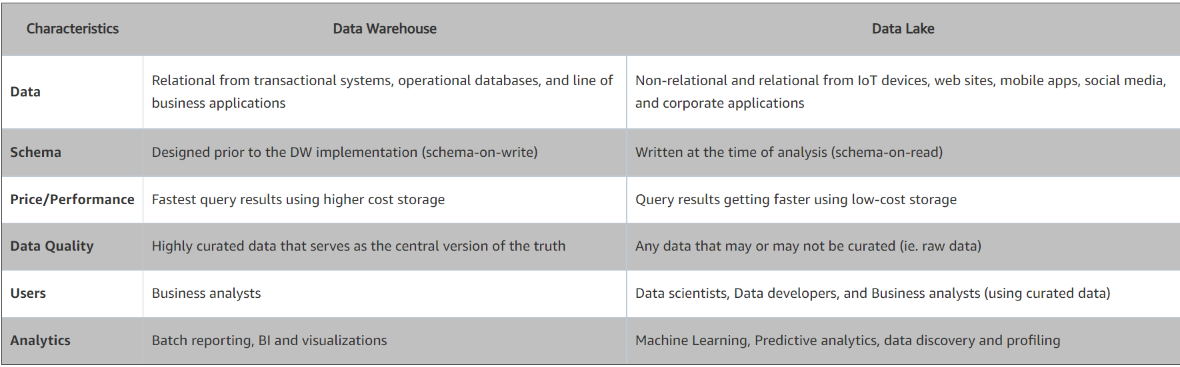
Datawarehouse and DataLake
Notes:
Normalization 3NF is the norm for data modeling techniques in OLTP

Slide 12
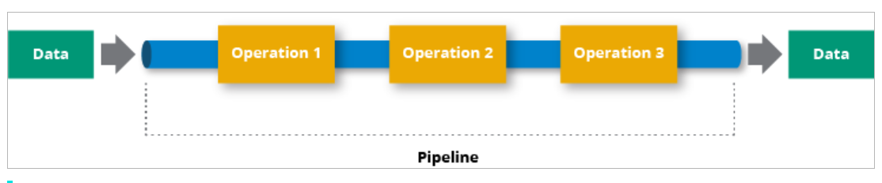
Data pipelines
A data pipeline is a series of data processing steps
Data pipelines consist of three key elements: a source, a processing step or steps, and a destination
Basic Architecture of Data pipeline
https://hazelcast.com/glossary/data-pipeline/
Notes:
Normalization 3NF is the norm for data modeling techniques in OLTP

Slide 13
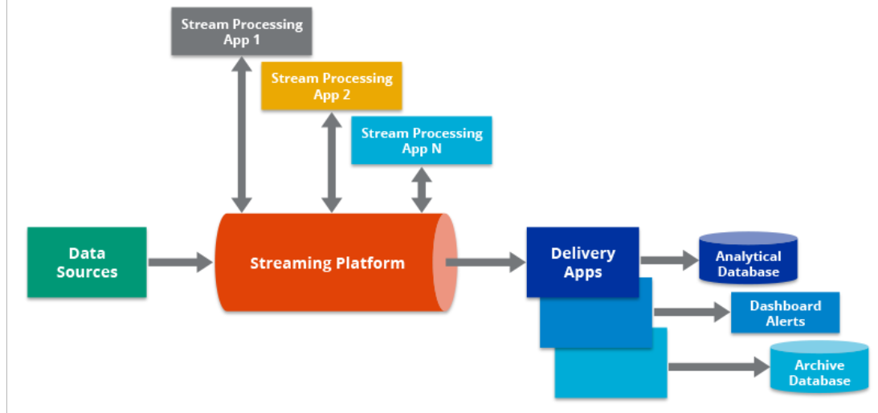
Data pipelines - contd
Streaming Architecture of Data pipeline
Notes:
https://hazelcast.com/glossary/data-pipeline/

Slide 14
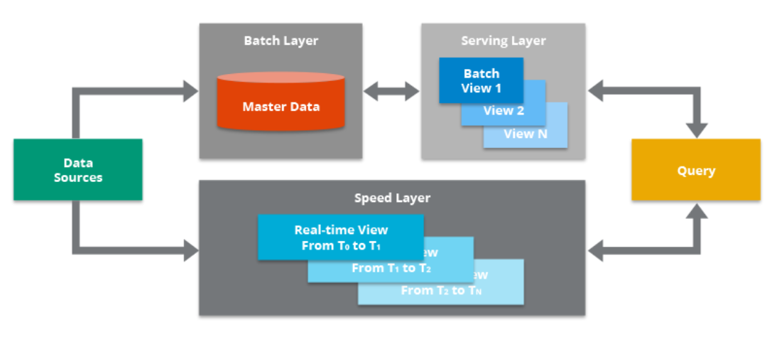
Data pipelines - contd
Lambda Architecture of Data pipeline
The Lambda Architecture accounts for both a traditional batch data pipeline and a real-time data streaming pipeline. It also has a serving layer that responds to queries.
Notes:
https://hazelcast.com/glossary/data-pipeline/

Slide 15
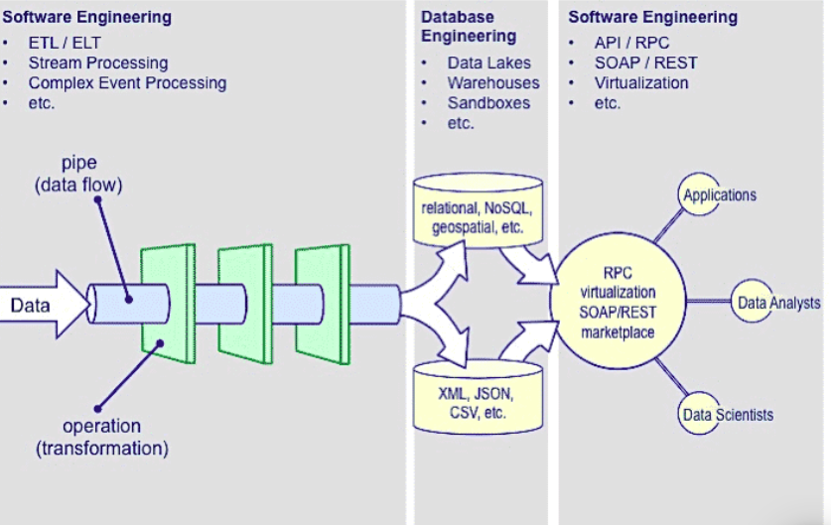
Data Engineering concept
Notes:
https://quanthub.com/what-is-data-engineering/

Slide 16
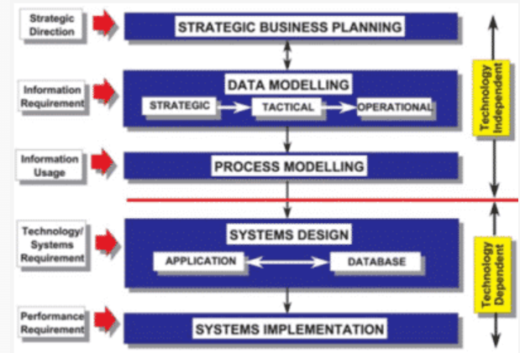
Data Engineering concept
Notes:
https://quanthub.com/what-is-data-engineering/

Slide 17
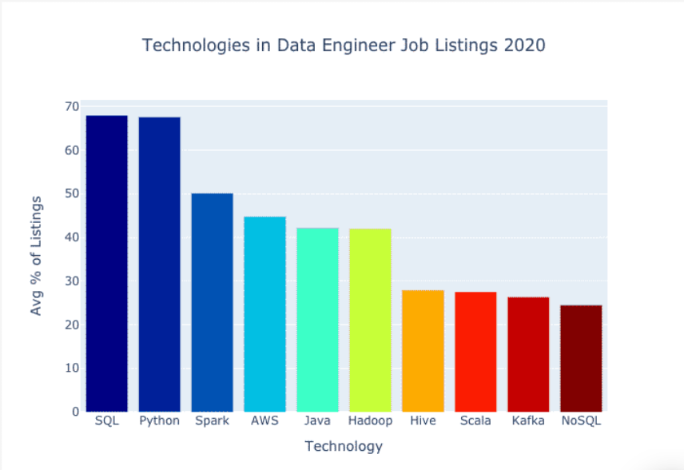
Technologies stack for Data engineering jobs
Notes:
https://quanthub.com/what-is-data-engineering/

Slide 18
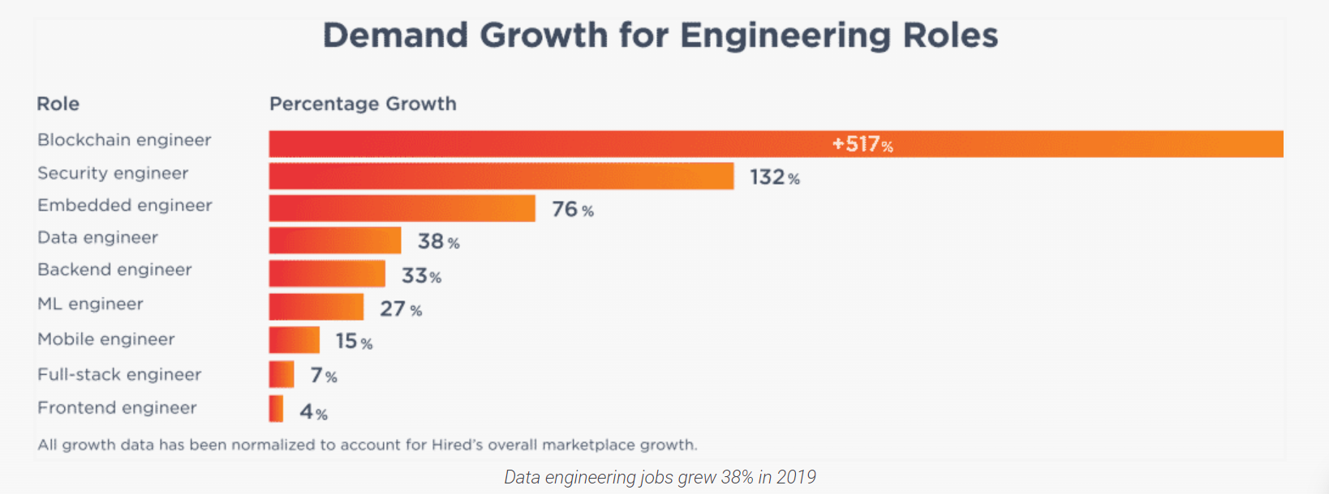
The Data Engineering roles prediction
Notes:
https://quanthub.com/what-is-data-engineering/

Slide 19
Resources for Data engineering concepts – good to read
https://www.altexsoft.com/blog/datascience/what-is-data-engineering-explaining-data-pipeline-data-warehouse-and-data-engineer-role/
https://mindtitan.com/resources/blog/what-is-data-engineering/
https://intellipaat.com/blog/what-is-data-engineering/

Slide 20
The Data challenge
This new data is different from the regular data in a couple of respects, not only is it often unstructured, it has high volumes and in many cases changes rapidly.
As Gartner defines it, this new data has
High Volume
High Velocity
High Variety
High veracity
High Complexity

Slide 21
The Data challenges… contd
The industry has tried to tackle this “Data Challenge” from different technology and process perspectives. Some methods to improve the handling of data and others to directly improve the subsequent usage (Analytics) of it.
Grid Computing (Volume)
Cloud Computing (Velocity & Volume)
Using Open Source Software (overall cost)
Virtualization (Time to Test/Deploy, Processing Capacity)
Innovations in BI – Real time & Operational (Velocity)
Dw Appliances (Volume)
Industry specific models and solutions (Time to Deploy, Complexity)

Slide 22
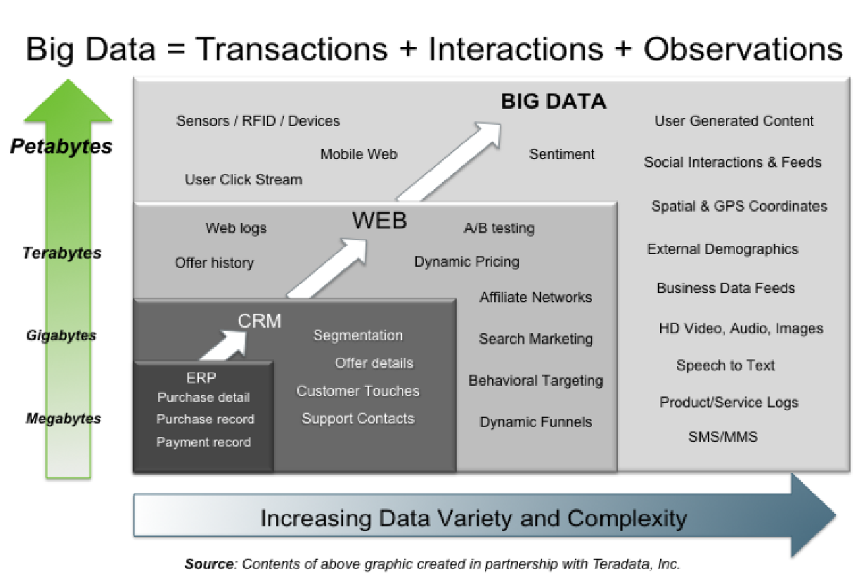
Understanding Big Data

Slide 23
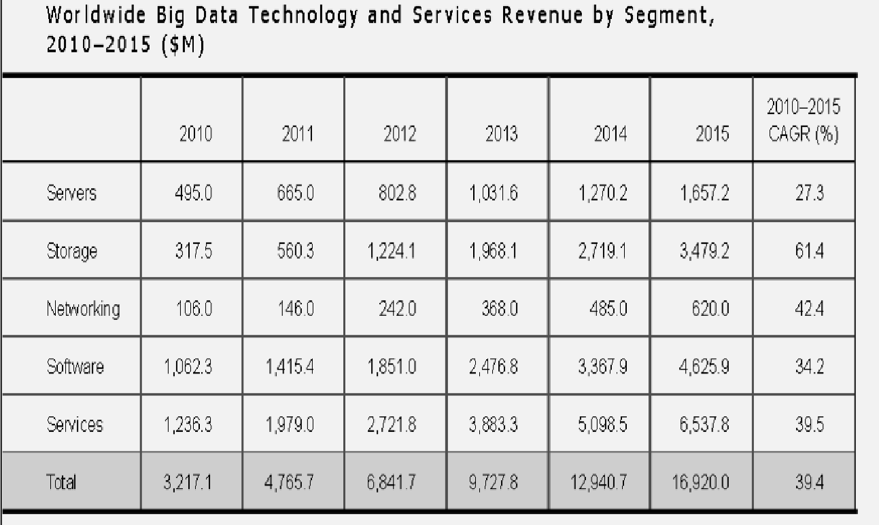
Understanding Big Data contd
Source: IDC Report – Worldwide Big data Technology & Services 2012 – 2015 forecast

Slide 24
Big Data Technology Landscape
Oracle Big data Reference Landscape
Teradata Big data Reference Landscape
Cloudera Enterprise
HortonWorks
MapR

Slide 25
Bigdata Use Cases
HealthCare
Retail
Manufacturing
Public Services
Telecom
Oil & Gas

Slide 26

Bigdata Use Cases – HealthCare
HealthCare
Clinical Decision Support System
Remote Patient Monitoring
Patient Profiling
Comparative Effective Research

Slide 27

Bigdata Use Cases – Retail
Marketing
Cross-Selling
Location-based Marketing
Analyzing in – store behavior
Sentiment Analysis

Slide 28


Bigdata Use Cases – Manufacturing
Manufacturing
Sensors Driven Operations
Supply Chain & Inventory Management
Shorten Design to Value Cycle

Slide 29
Bigdata Use Cases – Public Services
Public Sector Administration
Traffic Decongestion
Civic Compliance – Noise, Air & Water
Pollution
Locality and Area Development

Slide 30
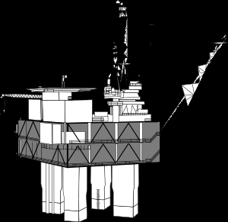
Bigdata Use Cases – Oil & Gas
Oil & Gas Sector
Digital Oil Field
Remote Drilling Operations

Slide 31
Limitations of Conventional BI
Conventional BI/Dw/Dss solutions – hardware, software and Architecture proved to be incapable of handling Bigdata.
Short Comings & Limitations of Conventional BI Architecture/Tools etc.
Prohibitively expensive solutions to handle Volume
Expensive, Complex and Unfeasible in handling of Variety
Design and Architecture not able to handle high Velocity
Inefficient and Expensive in handling Complexity

Slide 32
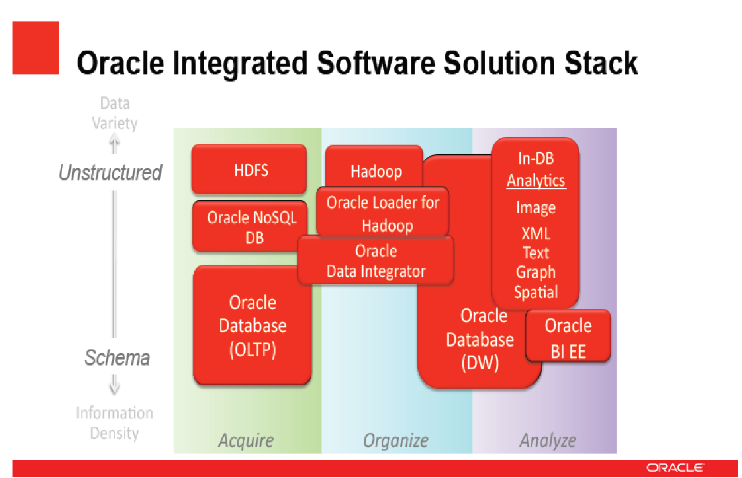
Oracle Bigdata Reference Landscape

Slide 33
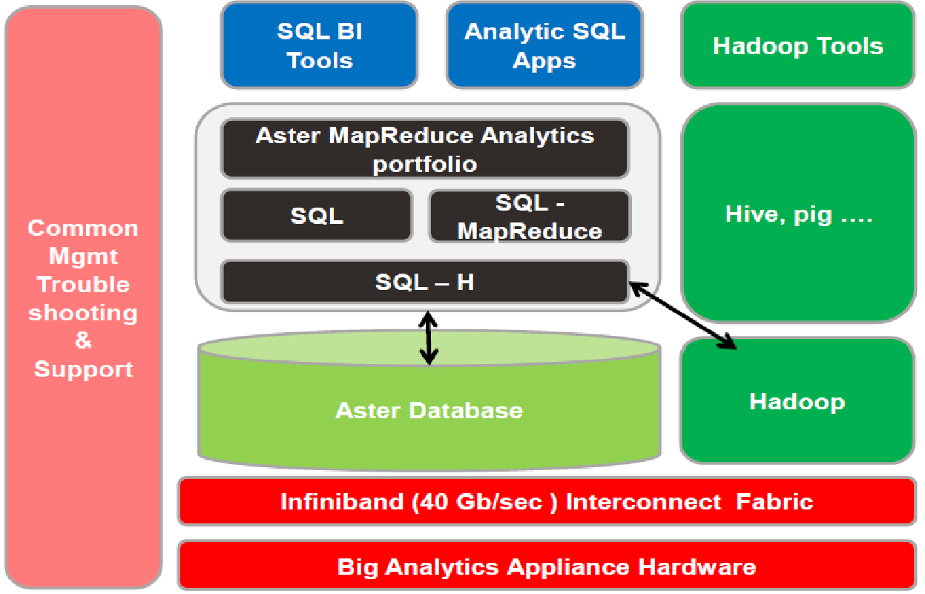
Teradata Bigdata Reference Landscape

Slide 34
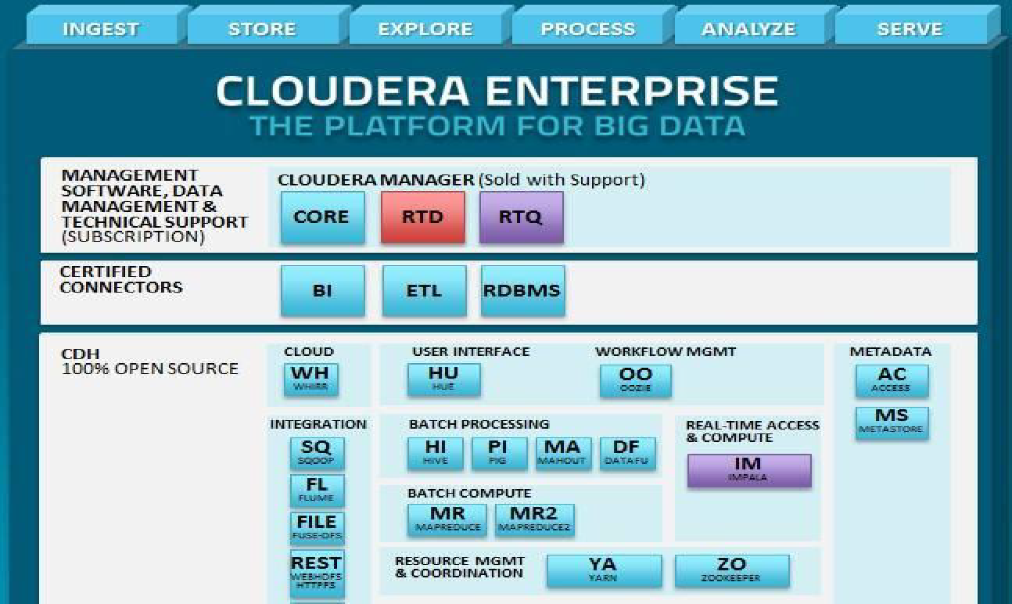
Cloudera Enterprise

Slide 35
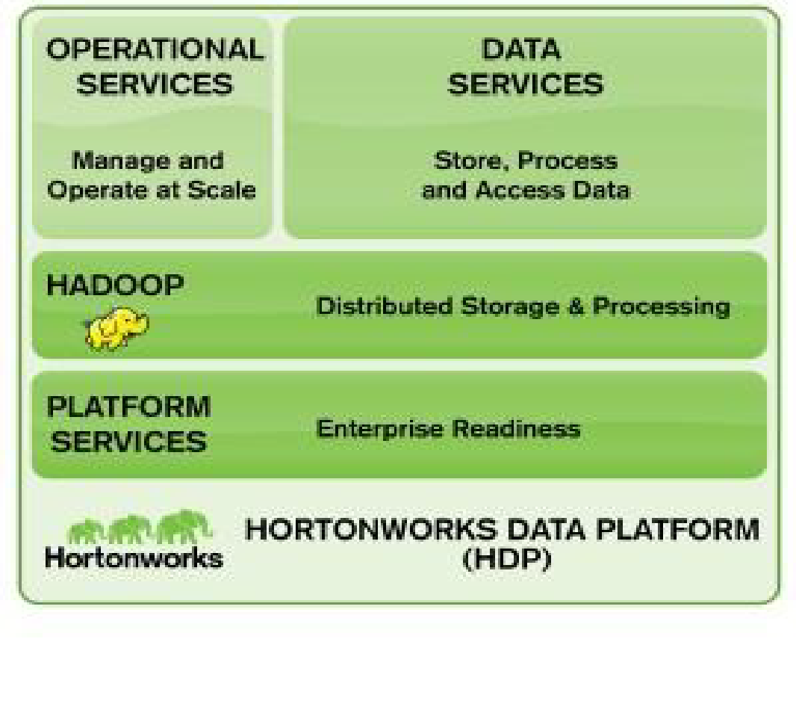
HortonWorks
HortonWorks has taken Apache Hadoop and given it performance tweaks and included some additional features to make the package attractive to Enterprise customers

Slide 36
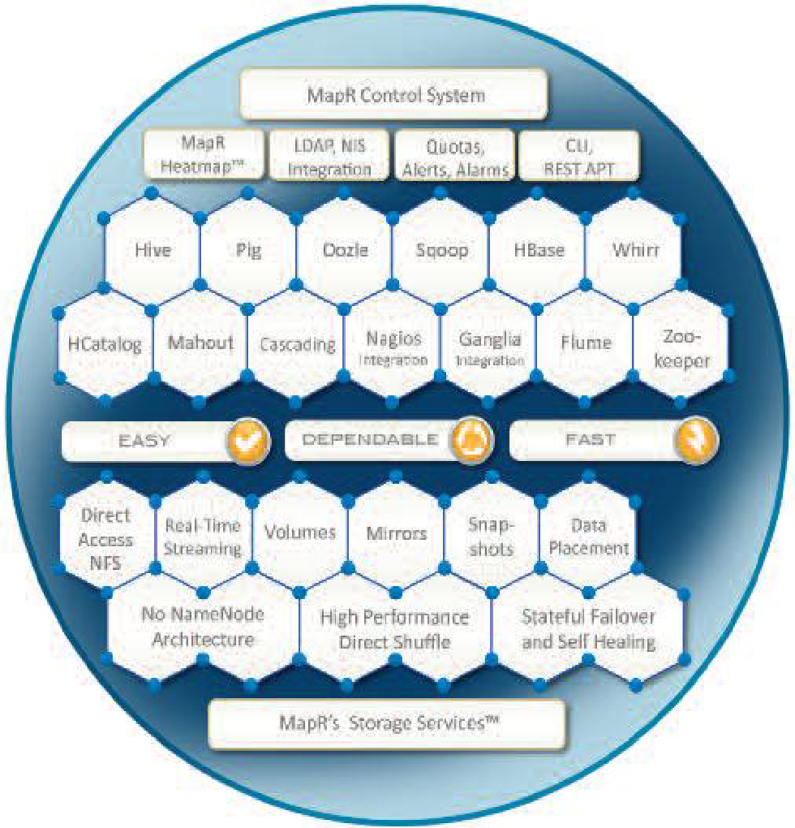
MapR
MapR too has taken Apache Hadoop and given it performance tweaks and additional features.
They claim a performance increase of 2 to 5 times
EMC’s Greenplum Pivotal HD is built on MapR

Slide 37

The Paradigm Shift
Clouds are slow, Grids are expensive, Open Source less robust, Virtual Servers tend to slow things down, Dw Appliances bring in a lot of hardware…
Enter
Hadoop is an Open Source data processing Architecture.

Slide 38
The Evolution of Hadoop
3 things which led to the evolution of Hadoop
-Hardware
-Data
-Software
Hardware – Last 40 years, unprecedented growth in the amount of computation that can be done on hardware – Moore’s Law
Data – Amount of data that can be stored per dollar has considerably increased. Data is very valuable. Having more data gives better insights.
Software – This was the gap. Something which could take advantage of the hardware and data available. HDFS & Map Reduce inspired from GFS & M/R
Differentiation – Commodity Hardware, Fault Tolerance / Reliable & Open Source
Developed by Doug Cutting. Hadoop was the name of his son’s toy elephant

Slide 39
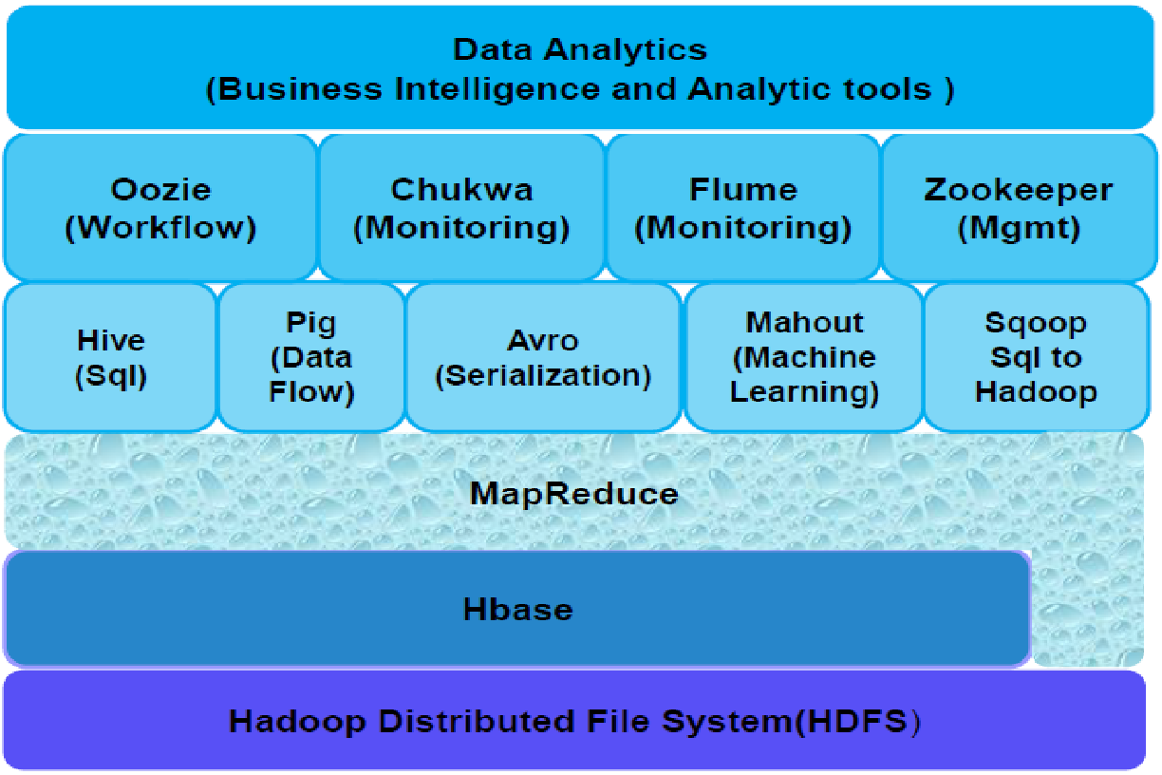
The Hadoop Ecosystem

Slide 40
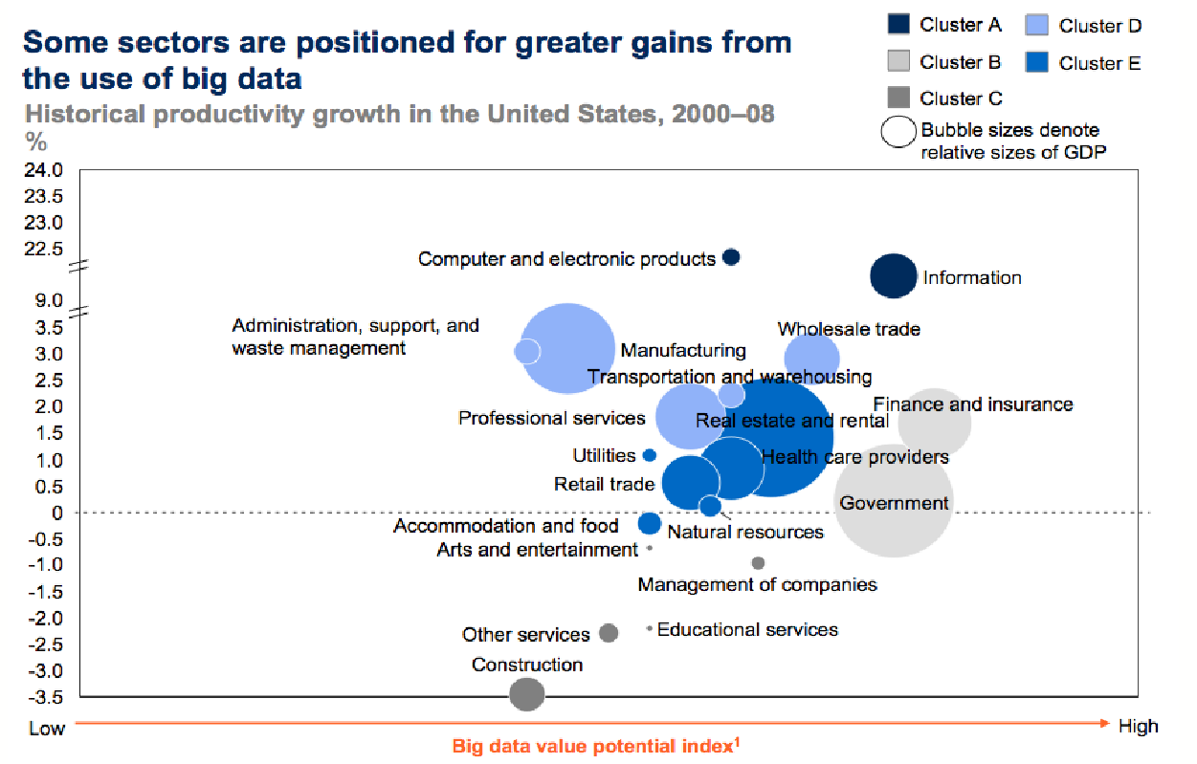
Big data Market

Slide 41
Q & A

